Slide 1
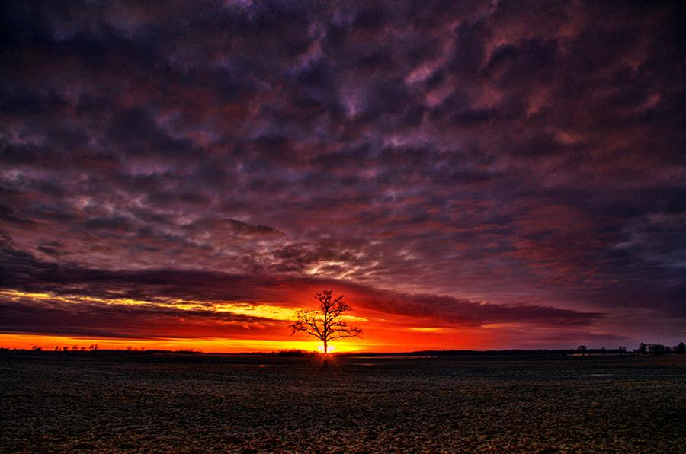
THE LIFE OF CHRIST
PART 44

Slide 2
John 6:16 Now when evening came, His disciples went down to the sea, ¹⁷ got into the boat, and went over the sea toward Capernaum. And it was already dark, and Jesus had not come to them. ¹⁸ Then the sea arose because a great wind was blowing. ¹⁹ So when they had rowed about three or four miles, they saw Jesus walking on the sea and drawing near the boat; and they were afraid.

Slide 3
One of the difficulties in answering this question comes from examining the meaning of the word “saw” from the Greek because it can mean to see something with the eyes and it can mean to perceive by any of the senses (Strongs).

Slide 4
When the wise men did not come back to Herod to tell him where Jesus was, “He saw that he was deceived by the wise men” (Mat. 2:16).

Slide 5
“So when the centurion and those with him, who were guarding Jesus, saw the earthquake and the things that had happened, they feared greatly, saying, "Truly this was the Son of God” (Mt. 27:54)!

Slide 6
ISBE says:
The boats were probably of a size and build similar to the few employed on the Lake today, which are between 20 and 30 ft. in length and 7 ft. in breadth (Ships and Boats).

Slide 7
This is backed up by archeology:
An ancient fishing boat, dating to the New Testament period, was found in the mud just north of Magdala in 1986. It was 26.5 feet long, 7.5 feet wide, and 4.5 feet deep, and was made of cedar and oak (Nelsons New Illustrated Bible Manners & Customs p. 457).

Slide 8
John 1:48 Nathanael said to Him, "How do You know me?" Jesus answered and said to him, "Before Philip called you, when you were under the fig tree, I saw you."

Slide 9
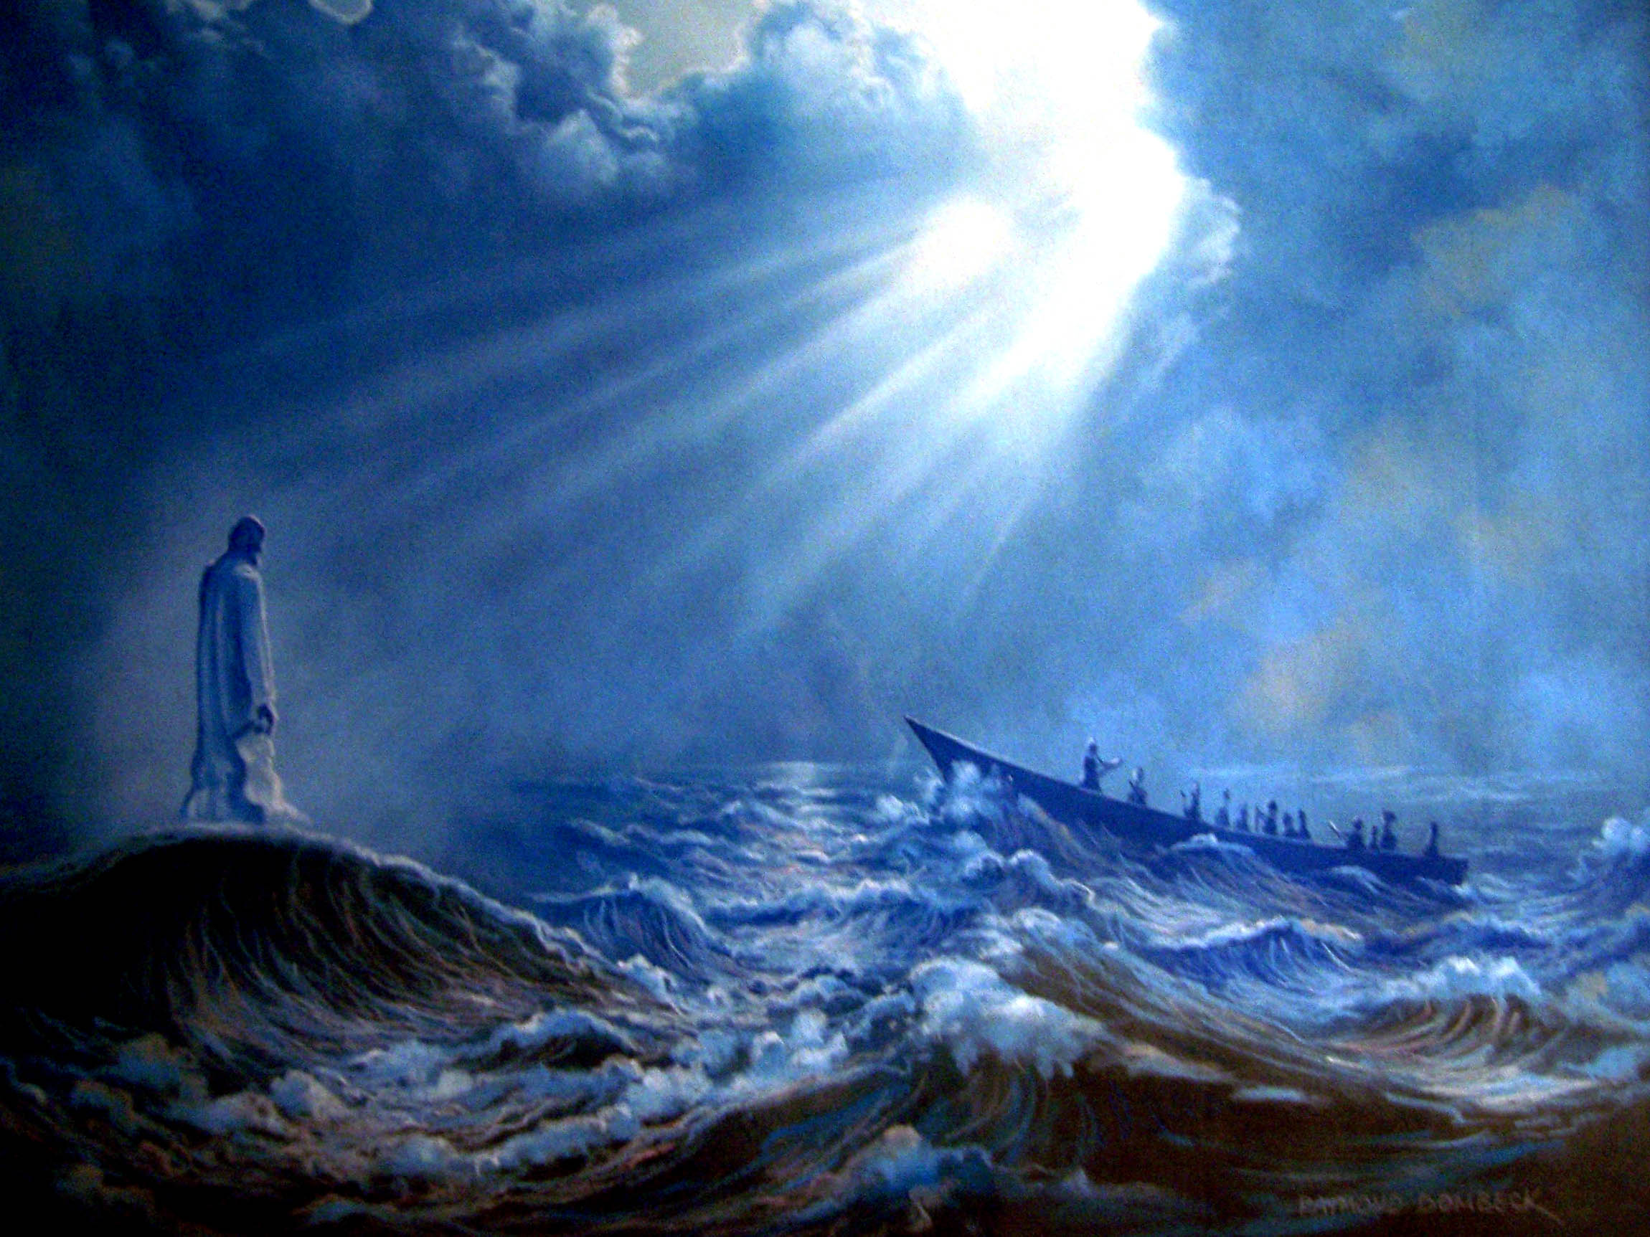

Slide 10
John 6:20 But He said to them, "It is I; do not be afraid."

Slide 11
Matthew 14:27 But immediately Jesus spoke to them, saying, "Be of good cheer! It is I; do not be afraid." ²⁸ And Peter answered Him and said, "Lord, if it is You, command me to come to You on the water." ²⁹ So He said, "Come." And when Peter had come down out of the boat, he walked on the water to go to Jesus. ³⁰ But when he saw that the wind was boisterous, he was afraid; and beginning to sink he cried out, saying, "Lord, save me!" ³¹ And immediately Jesus stretched out His hand and caught him, and said to him, "O you of little faith, why did you doubt?" ³² And when they got into the boat, the wind ceased. ³³ Then those who were in the boat came and worshiped Him, saying, "Truly You are the Son of God."

Slide 12
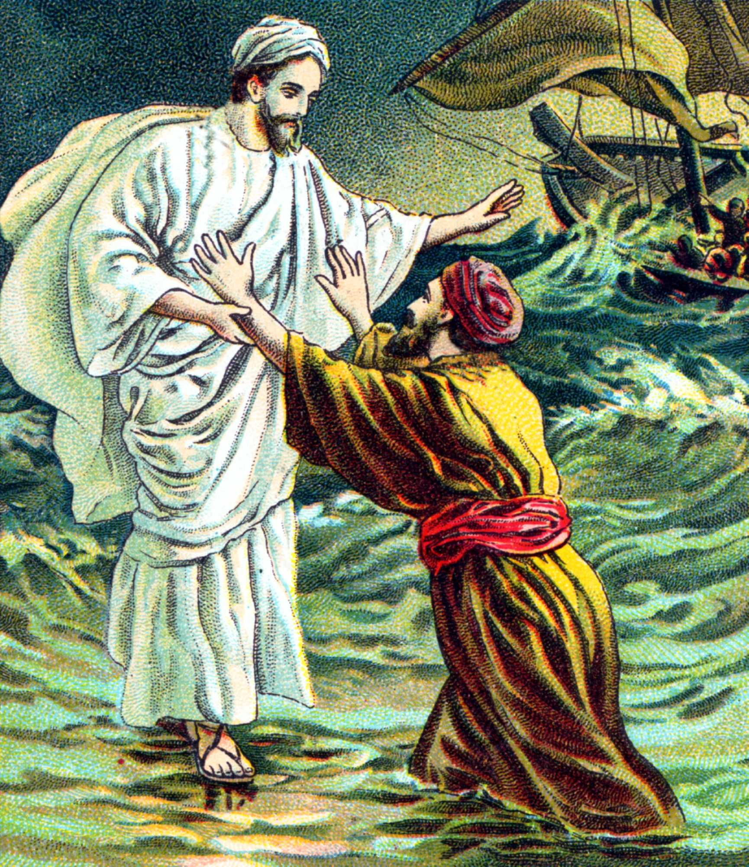
Mt. 26:35, 69-75; Acts 15:6-11; Gal. 2:11ff

Slide 13
Mark 6:51 Then He went up into the boat to them, and the wind ceased. And they were greatly amazed in themselves beyond measure, and marveled. ⁵² For they had not understood about the loaves, because their heart was hardened.

Slide 14
John 6:21 Then they willingly received Him into the boat, and immediately the boat was at the land where they were going.

Slide 15
Matthew 14:34 When they had crossed over, they came to the land of Gennesaret. ³⁵ And when the men of that place recognized Him, they sent out into all that surrounding region, brought to Him all who were sick, ³⁶ and begged Him that they might only touch the hem of His garment. And as many as touched it were made perfectly well. (See Mk. 6:53-56)

Slide 16
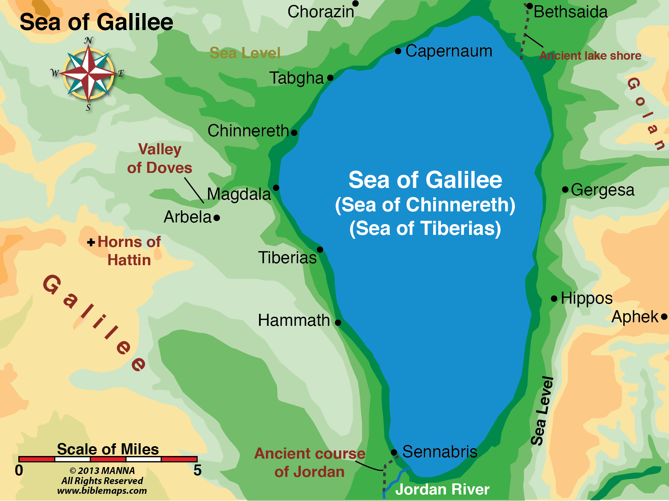

Slide 17
This district was a plain extending two kilometers (one mile) from the Sea of Galilee along a 5 kilometer (three mile) section of Galilee’s north shore (Nelson’s New Illustrated Dictionary p.487).

Slide 18
John 6:22 On the following day, when the people who were standing on the other side of the sea saw that there was no other boat there, except that one which His disciples had entered, and that Jesus had not entered the boat with His disciples, but His disciples had gone away alone -- ²³ however, other boats came from Tiberias, near the place where they ate bread after the Lord had given thanks -- ²⁴ when the people therefore saw that Jesus was not there, nor His disciples, they also got into boats and came to Capernaum, seeking Jesus.

Slide 20
Mr. Coffman makes the following observation about these boats: “John's mention of the boats from Tiberius in this place is a reference to taxi boats which, after the storm subsided, had gone to Bethsaida Julius in search of fares” (Commentary on John).

Slide 21
“Bethsaida at the northern end of the Lake and Tarichea at the southern end were great centers of the trade” (Ships and Boats).

Slide 22
John 6:25 And when they found Him on the other side of the sea, they said to Him, "Rabbi, when did You come here?"

Slide 23
John 6:26 Jesus answered them and said, "Most assuredly, I say to you, you seek Me, not because you saw the signs, but because you ate of the loaves and were filled. ²⁷ "Do not labor for the food which perishes, but for the food which endures to everlasting life, which the Son of Man will give you, because God the Father has set His seal on Him."

Slide 25
1 Corinthians 14:26 How is it then, brethren? Whenever you come together, each of you has a psalm, has a teaching, has a tongue, has a revelation, has an interpretation. Let all things be done for edification.

Slide 26
According to Strongs, edification means this:
1) (the act of) building, building up 2) metaph. edifying, edification 2a) the act of one who promotes another's growth in Christian wisdom, piety, happiness, holiness

Slide 27
Philippians 2:3 Let nothing be done through selfish ambition or conceit, but in lowliness of mind let each esteem others better than himself. ⁴ Let each of you look out not only for his own interests, but also for the interests of others. ⁵ Let this mind be in you which was also in Christ Jesus,

Slide 28
John 4:23 "But the hour is coming, and now is, when the true worshipers will worship the Father in spirit and truth; for the Father is seeking such to worship Him. ²⁴ "God is Spirit, and those who worship Him must worship in spirit and truth."

Slide 29
Ephesians 5:19 speaking to one another in psalms and hymns and spiritual songs, singing and making melody in your heart to the Lord,
Colossians 3:16 Let the word of Christ dwell in you richly in all wisdom, teaching and admonishing one another in psalms and hymns and spiritual songs, singing with grace in your hearts to the Lord.

Slide 30
John 6:26 Jesus answered them and said, "Most assuredly, I say to you, you seek Me, not because you saw the signs, but because you ate of the loaves and were filled. ²⁷ "Do not labor for the food which perishes, but for the food which endures to everlasting life, which the Son of Man will give you, because God the Father has set His seal on Him."

Slide 31
Matthew 4:4 But He answered and said, "It is written, 'Man shall not live by bread alone, but by every word that proceeds from the mouth of God.' " See also Job 23:12

Slide 32
John 4:32 But He said to them, "I have food to eat of which you do not know." ³³ Therefore the disciples said to one another, "Has anyone brought Him anything to eat?" ³⁴ Jesus said to them, "My food is to do the will of Him who sent Me, and to finish His work.

Slide 33
He could offer eternal life because the Father has set His seal on Him.

Slide 34
John 6:28 Then they said to Him, "What shall we do, that we may work the works of God?" ²⁹ Jesus answered and said to them, "This is the work of God, that you believe in Him whom He sent."

Slide 35
Usually the word “believe” or “faith” is used as a synecdoche. This word means “A figure of speech in which a part is used for the whole or the whole for a part…” (dictionary.com).

Slide 36
“You see then that a man is justified by works, and not by faith only” (Jas. 2:24).

Slide 37
Colossians 2:11 In Him you were also circumcised with the circumcision made without hands, by putting off the body of the sins of the flesh, by the circumcision of Christ, ¹² buried with Him in baptism, in which you also were raised withHim through faith in the working of God, who raised Him from the dead.

Slide 38
